Slide 1
Customer Satisfaction: Walmart
Student Name
Course Number
Due Date
Faculty Name

Slide 2
OVERVIEW
Introduction
Findings
Recommendations
References

Slide 3
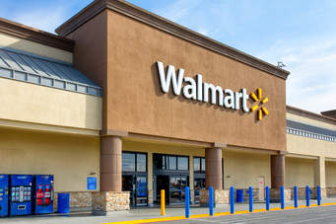
INTRODUCTION
Walmart is an American multinational retail firm
It is among the largest grocers in the United States.
It is the largest discount store in the world (“Walmart,” 2021)

Slide 4
Continues
The report aims at studying Walmart
mainly on customers’ experience in regard to the firm
We will conduct an online customer satisfaction surveys.
This will allow us to collect valuable information

Slide 5
FINDINGS
The study aims at understanding the clients as well as customers’ perception of Walmart
Out of 4500 reviews Walmart scored 3.46 stars
Walmart has several factors which tend to have negative impact on client’s satisfaction.
There are factor which motivate customers to continue shopping with Walmart

Slide 6
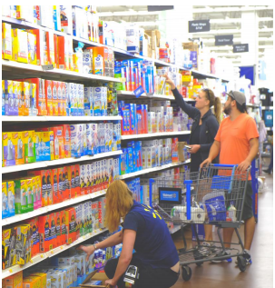
Causes of poor customer experience
The store is too big to move around
Unfriendly as well as unhelpful employees
The big shopping carts from the firm are inconvenient
Long waits at the checkout and the return lines (Hill, 2015)

Slide 7
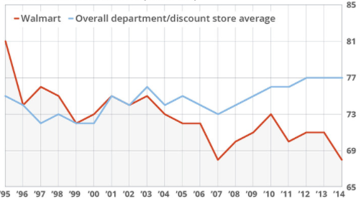
Customer Satisfaction Scores (out of 100)

Slide 8
Why Walmart?
It has low product prices
Walmart stores are located in a convenient place
Offers a wide variety of products
Enables the client to conduct product comparison (NCR, 2017)

Slide 9
RECOMMENDATIONS
In order to enhance shopping and checkout efficiency the management should:
  Consider technologies to enhances customer shopping efficiency
  Remodeling the infrastructure
  Expand the checkout options

Slide 10
continues
In order to enhance customer services the management should
  Develop policies which will guide employees on how to address the clients.
  Develop rewarding programs for the associates with high standard services
  Establish effective training programs

Slide 11
CONCLUSION
Walmart’s clients main complain were on:
  Quality as well as availability of products
  Accessibility as well as the friendliness of the firm
  The firm should work on these issues in order to increase their sales and profits

Slide 12
REFERENCES
Hill, C. (2015). 4 reasons Walmart is the most-hated retailer in America. Retrieved from https://www.marketwatch.com/story/4-reasons-walmart-is-the-most-hated-retailer-in-america-2015-02-18
NCR. (2017). Walmart Research Report. Retrieved from https://uploads-ssl.webflow.com/5a71e117ead1240001ec3118/5a827b7232f0d300017eafae_Team%205%20_%207%20Meta%20Process%20Book_Finalized-min.pdf
Walmart. (2021). Retrieved from https://www.walmart.com/grocery

